Slide 1
Capgemini India – PeopleSoft Practice
Capgemini India – PeopleSoft Foundation Training Overview Presentation
March 2007

Slide 2

Agenda
PeopleSoft Foundation
Navigating the System
Understanding the terminology
Documentation Available
Available modules
Technical Architecture - overview
PeopleTools - overview
Q & A

Slide 3
Capgemini India – PeopleSoft Practice
PeopleSoft Foundation

Slide 4
PeopleSoft Foundations
100% Internet based technology
Based on PeopleSoft Meta-Data which serves as a layer between Database system tables and PeopleSoft Objects
Based on flexible architecture which supports various Operating systems, Databases and third party products
Flexible setup which allows user to setup entities specific to the needs of the organization (SETID, BUSINESS UNIT and so on)
Portal based navigation
Easily customizable
Delivered Integration tools
Supports Multi-Language environments
Reporting tools- SQR, Query, Crystal reports

Slide 5
Capgemini India – PeopleSoft Practice
Navigating the System

Slide 6
Navigating the System
Significantly improved navigation with version 8.4
Portal Based navigation
Can be categorized in following way
  Setup related (Defining Business unit defaults)
  PeopleTools based (Setting up user security)
  Self-Service related (Creating an expense report)
  Transactions related (Entering a voucher)
Allows user to run Reports in various formats and output can be viewed through browser

Slide 7
Examples
Navigate to Setup Financials/Supply chain -> business unit related ->Payables
Navigate to PeopleTools -> Security ->User Profiles -> User Profiles
Navigate to Employees Self-Service -> Travel and Expenses -> Travel & Expense Home -> Create an expense report
Navigate to Accounts Payable -> AP Home page -> Voucher Entry
Navigate to Setup Financials/Supply Chain -> BU Related -> Reports ->GL Units and run a report

Slide 8
Capgemini India – PeopleSoft Practice
Understanding the Terminology

Slide 9
Understanding the Terminology
SETID – An identification code that represents a set of control table information or TableSets. A TableSet is a group of tables (records) necessary to define your company's structure and processing options. Key to most of the setup tables
BUSINESS UNIT – An identification code that represents a high-level organization of business information. You can use a business unit to define regional or departmental units within a larger organization.Key to most of the transaction tables
PEOPLETOOLS – Various tools used to build and deploy the application are collectively referred as PeopleTools. e.g.: Application designer, Query
FIELDS – Entity that resides in PeopleSoft Meta-data which is used to form records

Slide 10
Understanding the Terminology (cont…)
RECORDS – Logical grouping of PeopleSoft fields. Differs from database ‘table’. Records can be database table, View, Dynamic view, Derived record, Temporary table
PAGES – Means of displaying/inputting data
COMPONENTS – Logical grouping of pages
MENUS – Translated into link that user can access to navigate to various components
PROJECTS – Collection of various types of PeopleTools Objects. Typically used for migration to other environments
SQR – “Structured Query Reports” – Reporting language used by PeopleSoft

Slide 11
Understanding the Terminology (cont…)
QUERY – Reporting tool which can be used by end uses to retrieve data without having to code any SQLs. System generated the SQL
PEOPLECODE – Proprietary language used for online programming
PEOPLECODE EVENTS – Actions that trigger certain Peoplecode to execute e.g. RowInit, FieldChange, SaveEdit
RUN CONTROL ID – ID used by a user to run a report in the system. Combination of USERID and RUN CONTROL ID helps determine the “run control parameters” for a reports/processes
REPORT REPOSITORY – Directory on Web Server where Reports are stored for viewing

Slide 12
Understanding the Terminology (cont…)
EFFDT –Effective Date is a date on which a table row becomes effective; the date that an action begins. For example, the General Ledger Account page contains Effective Date and is used in conjunction with Status to determine on which date the Account is activated or inactivated. Most of the setup tables are Effective Dated, so history, current and future data can be tracked easily.
APPLICATION ENGINE – Integrated programming language used for developing “Processes”
DEFERRED PROCESSING – Special processing mode in order to improve performance. This mode delays all PeopleCode processing till next trip to Application Server
CHARTFIELDS - Fields that store your charts of accounts and provide your system with the basic structure to segregate and categorize transactional and budget data are called ChartFields.e.g: ACCOUNT, DEPT, PROJECT_ID

Slide 13
Capgemini India – PeopleSoft Practice
Documentation Available

Slide 14
Documentation available
Peoplebooks
    http://ntbompsft01:8095/PSOL/htmldoc/eng/index.htm
    http://ntbompsft01:8095/PSOL/htmldoc_crm/eng/index.htm
Customer connection
    http://www.peoplesoft.com

Slide 15
Capgemini India – PeopleSoft Practice
Available Modules

Slide 16
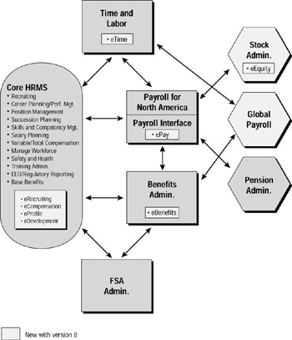
Available modules
(Complete listing is attached at the end of the presentation)
HCM Modules

Slide 17
Available modules (cont…)
HCM Modules (Cont…)
Core HRMS The core PeopleSoft HRMS application, which includes Manage Workforce, contains the basic functions to hire, transfer, promote, and make job changes for an employee. This portion of the application contains the basic employee information, including history as well as department, location, and job information. Concepts to support basic EEO, affirmative action, labor relations, employment verifications, and basic HR functions are contained in this module. With PeopleSoft 8, an additional module, eProfile, allows employees themselves to update basic employee or profile information.
Career Planning/Performance Management This functionality is included as part of the core HRMS module. This area supports major career planning processes such as competency planning, career management, employee review processing, and succession planning. With PeopleSoft 8, a new module, eDevelopment, is also available, providing manager and employee features to help individuals manage their careers more effectively over the Internet.
Recruiting This functionality is also included as part of the core HRMS module. The recruiting function includes creation of job requisitions and job search or skill search capabilities including applicant tracking, interviewing, and hiring. This application integrates directly with the basic employee information such that applicant data is transferred directly to employee tables once an applicant is hired. A new module in PeopleSoft 8, eRecruit, allows for full external recruiting capabilities enabled through Web technology.
Position Management The Position Management functions support budgeting and managing job positions within an organization. This functionality, included in the core HRMS application, is typically used for governmental or regulatory establishments that have a predefined budget and a set of job positions that are authorized for employment. Companies that let each manager determine job requirements, which are not tracked on a fixed job basis, don't implement this feature.

Slide 18
Available modules (cont…)
HCM Modules (Cont…)
Variable/Total Compensation The features of this capability are part of the core HRMS application. This module allows you to create variable compensation plans and administer them to your staff using eligibility criteria calculation methods, and provides specific payout options for your employees (such as a special bonus check, an incentive payment, or a salary increase). Incentive goals, both group and individual, can be set up as well. A manager's self-service module, eCompensation, is provided with PeopleSoft 8; it allows managers to perform key compensation planning functions, leveraging the Internet.
Payroll for North America This major application area for the U.S. and Canada includes the processes that support the payroll and pay the employees, including the processing of specific earnings and deductions as well as both on- and off-cycle payrolls. In addition to these features, PeopleSoft 8, with its new ePay module, allows paycheck presentation and electronic stub review via the Internet.
Payroll Interface This feature includes processing to support the calculations of benefits and deductions, which can be passed to a third-party vendor for payroll purposes. It includes an interface generator that can create specific files that can integrate with payroll outsourcing vendors such as ADP (Automatic Data Processing, Inc.).

Slide 19
Available modules (cont…)
HCM Modules (Cont…)
Time and Labor The Time and Labor application has improved over the past few PeopleSoft releases and now supports online (even Web-enabled) time collection, including maintenance of schedules and pay or time rules and retroactive processing. This application interfaces closely with the Payroll module and passes "buckets" of time and expenses by pay period to the pay sheets (found in the Payroll module) used to create the employee paychecks. Another module, Time and Attendance, is also available but only with the Asia/Pacific local version. In addition to this core functionality, PeopleSoft 8 also includes a Web-based, employee self-service module called eTime.
Stock Administration This is one of PeopleSoft's newest HRMS modules. It supports the tracking of employee stock programs and distributions, including stock purchase plans, restricted stock payments, and stock options.
FSA Administration This module creates and tracks flexible spending accounts (FSAs) for employees, including tracking deductions, contributions, and reimbursements. Most companies outsource this service and therefore do not need this module. The FSA deduction can be created and tracked within the Payroll module without the use of this additional module.
Global Payroll This module is new with PeopleSoft 8 and provides a global payroll engine that supports payroll processes for four countries initially: the U.K., France, Germany, and Switzerland. Payroll for North America is still available as well to support the requirements of the U.S. and Canada.

Slide 20
Available modules (cont…)
HCM Modules (Cont…)
Training Administration The Training Administration module is also included in the core HRMS product. Within this area, training programs can be set up and sessions scheduled to enroll and track employee training. Information on each course and session can be tracked, including instructors and class requirements. Waiting-list features are included.
Pension Administration Pension Administration is a fairly new application that provides the capability to track and manage pension deductions and allocations, which are then passed to the plan provider. This module is only U.S.-based at this time and doesn't support pension requirements globally. It isn't included as a part of the core HRMS product and must be purchased separately.
Benefits Administration and Base Benefits Two types of benefits processing are available with PeopleSoft. Base Benefits processing, which is included in the core HRMS application, provides for the basic tracking of benefit plans and links each plan to a payroll deduction. However, any changes to the plan or enrollment processing is done manually. Benefits Administration allows you to automate the benefits enrollment and change process. This module is an add-on to the core package. With PeopleSoft 8, a new module called eBenefits supports key employee self-service features, allowing employees to enroll in their benefit plans and make changes to them. It's available at an additional price.
Salary Planning This function is included in the core HRMS application. It features the ability to create salary plans, develop salary-increase budgets by department, and process salary changes. Standard salary matrices and review-rating distributions can be accomplished by leveraging this functionality.

Slide 21
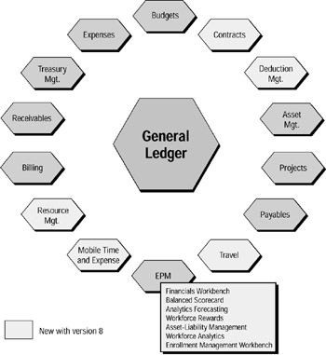
Available modules (cont…)
Financials Modules

Slide 22
Available modules (cont…)
Financials Modules (Cont…)
General Ledger This module was part of the initial release and includes the basic features that support a general ledger financial application, including chart-of-accounts setup and maintenance, basic ledger accounting, allocations, chartfield combination edits, consolidations, and equalizations. It also contains financial reporting tools, including the proprietary nVision (an Excel-based drill-down reporting tool).
Accounts Payable Another original module, Accounts Payable includes the ability to track vendors and process payments for vouchers. It's heavily integrated with other modules, including General Ledger, Purchasing, Asset Management, Projects, and Accounts Receivable. It includes an EDI (electronic data exchange) interface capability.
Asset Management This function allows companies to track their assets, including contracts and leases, and perform the financial depreciation requirements. It interfaces with Accounts Payable, Projects (costing), and General Ledger.
Accounts Receivable This module supports customer tracking, core billing, cash processing, payment predicting, adjustments, and bank processing. It includes an EDI interface capability.
Budgets This module interacts closely with General Ledger and provides the capability for the organization's budget management process.
Projects The Projects capability includes the ability to track all aspects of a "project," including management of resources, budgeting, and reporting features.
Treasury The Treasury module supports the areas and functions of cash management, deal management, and risk management. This application is a fairly new set of functions, released in version 7.5.
Deduction Management This is another new module with a controlled release in PeopleSoft 8. It provides a credit and collections tool that allows companies to analyze their customer deduction trends and activities. This capability is extremely beneficial to the consumer products industry.

Slide 23
Available modules (cont…)
Financials Modules (Cont…)
Expenses This is also a fairly new module, with initial release in version 7.5, and includes the tracking and management of employee expenses and payments. This module integrates with Accounts Payable and the HRMS/Payroll modules to obtain vendor, employee, and payment information. With PeopleSoft 8, several new modules that together create an integrated travel-and-expense, self-service function called Mobile Travel and Expense are available. Features to support deployment on a PalmPilot are also available. The Travel module provides the ability to make and track travel arrangements and to integrate them with time-and-expense reporting.
Billing This function integrates specifically with the Accounts Receivable function to provide the billing capabilities necessary for an organization to bill customers. It includes the support for Web-based credit card payments and installment billing. A Web-based electronic billing and presentment/payment function is also provided.
Contracts Contracts is the newest of the financial modules, with a controlled release in PeopleSoft 8. (A controlled release is provided only to a pre-qualified set of clients and is not available to the general public.) This module tracks the revenue-generating contractual process for business-to-business transactions. Features of this module include creation and tracking of proposals, capturing contractual terms and conditions, support of billing and revenue-recognition processes, tracking of contractual deliverables, and analysis of earned and unearned revenue.
Resource Management This is the last of the three new modules having a controlled release in PeopleSoft 8. It supports the resource-planning needs of professional services companies by tracking project requirements and the skills matching those requirements.
Enterprise Performance Measurement (EPM) The EPM module is the core data reporting repository supported by a data warehouse. It includes key performance reporting features such as the balanced scorecard; workbenches for contracts, employees, and procurement; and tracking using key performance indicators (KPI).

Slide 24
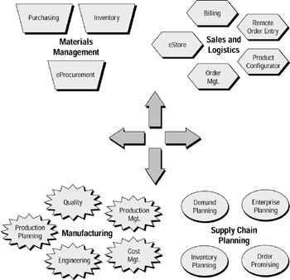
Available modules (cont…)
Distribution and Manufacturing Modules

Slide 25
Available modules (cont…)
Distribution and Manufacturing Modules
Sales and Logistics
Order Management The Order Management function supports product and customer definition, pricing, and ordering. It integrates with self-service Web applications including a Remote Order Entry module.
Product Configurator This module allows the capability to support configurable products and creates sales orders and manufacturing orders in assemble-to-order and make-to-order environments.
eStore The first full-featured Web solution from PeopleSoft (initially released in mid-1999) was this out-of-the-box storefront, which is tightly integrated with Order Management and Inventory. Another new module called Mobile Store is also available for ordering via a mobile environment (such as a PalmPilot).
Order Promising The Order Promising process checks the entire supply chain for available inventory, capacity, constraints, and alternatives. It also supports sourcing capabilities, change orders, ship-from site selection, and automatic updating of orders.
eBill Payment This module allows for a customer self-service starter kit for electronic bill presentment and bill payment.
In addition to these modules, PeopleSoft Billing and Receivables are included with this suite of products. These modules are described above in the financial applications section.

Slide 26
Available modules (cont…)
Distribution and Manufacturing Modules (Cont…)
Materials Management
Purchasing One of the core modules in the Materials Management area, Purchasing features the tracking of purchases including requisition processing, contracts, purchase orders, and matching (including procurement cards, integration of handheld devices, and electronic procurement). The module is integrated with CommerceOne's market site and an internal Internet "buy" capability to create PeopleSoft's new eProcurement application. Later we'll discuss in a bit more detail the eProcurement capabilities as well as other Internet-enabled processes.
Inventory This module supports core inventory tracking and processing, including item definition, costing features, put-away, replenishment, and structure inventory to fit organizational needs, as well as integration of bar coding, lot and serial number controls, data collection, and report analysis.
eSupplier Collaborator This unique function forecasts demand based on order history, economic indicators, and input from employees, suppliers, and customers. It looks at when and where to produce and distribute finished products and how to establish reliable promise dates for customer orders. This function is new with PeopleSoft 8 and incorporates major features from the Internet.
Also included in the Materials Management suite of products are PeopleSoft Payables, Expenses, and Asset Management, all of which are described within the financial products section above.

Slide 27
Available modules (cont…)
Distribution and Manufacturing Modules (Cont…)
Supply Chain Planning
Demand Planning This Demand Planning function is based on the Red Pepper capabilities and includes collaborative forecasting, product life-cycle planning including promotions, competitive and seasonal analysis, and adjustments. It includes safety stock, levels and exception detection, and correction.
Order Promising The Order Promising process checks the entire supply chain for available inventory, capacity, constraints, and alternatives. It also supports sourcing capabilities, change orders, ship-from site selection, and automatic updating of orders.
Enterprise Planning (Red Pepper) The Enterprise Planning module supports the optimization engine provided by the Red Pepper product, creating optimized balance between the production and supply chains. It includes the use of bills of distribution, constraints and performance factors, and real-time asset optimization in advanced planning and scheduling for the global supply chain. It also balances inventory and replenishment, and it plans resources and materials at the correct level of detail using modeling options.
Inventory Planning The PeopleSoft Inventory Planning module allows you to simulate the effects of various stocking scenarios so that you can select the best strategy possible. You can compare current policy with simulated policies to improve inventory levels—for example, you can compare the cost difference between 90% and 95% service levels. Inventory Planning assists in understanding the interrelationships among forecast demand and inventory investment, inventory turns, customer service levels, frequency of replenishment, and levels of safety stock. You can choose from several different methods for determining order quantity and safety stock, and then see the effect of the variations on time-phased inventory investment, inventory turns, and customer service levels.

Slide 28
Available modules (cont…)
Distribution and Manufacturing Modules (Cont…)
Manufacturing
Bills and Routings This module creates and maintains the bills of material (BOM), resources, work centers, tasks, and routings, and it understands features such as revision control, component yield, and master routings.It tracks production orders and quantities being manufactured.
Engineering The Engineering module supports the engineering process in managing product introductions and changes, including engineering change requests (ECR), engineering change orders (ECO), version/revision control, and engineering bills and routings. The module helps streamline documentation management, it associates documents with ECOs/ECRs, and it creates an engineering workbench to support engineering without affecting production.
Cost Management This module supports inventory costing and performance management methods, tracking of costs in production and in the finished goods supply chain, evaluations, and cost simulations. It looks at cost roll-ups, different cost types, and different methods of updating production costs; and it communicates those changes that affect item or production costs, using work flow.
Production Management The Production Management module supports the planning and scheduling methods within the production environment. It also supports methods of converting planned orders to production orders and schedules and methods of tracking production. It looks at collection methods, closing and re-opening orders, and schedules, and provides visibility of cost variances.

Slide 29
Available modules (cont…)
Distribution and Manufacturing Modules (Cont…)
Production Planning This module supports the planning and optimization of plant-level procurement and production on a real-time basis, and it determines available capacity and load of key resources in order to decide whether or not to accept a proposed customer order. Utilizing modeling options, it also determines the correct level of detail and adjusts constraints and performance factors to produce what-if scenarios.
Quality The Quality module monitors and collects quality data over the entire supply and manufacturing production chain. Included with this module are the creation and tracking of quality control plans, feedback, process data, analysis of data, and adjustment of production processes based on results.
Flow Production and eProduct Management These are two new modules found in Manufacturing in PeopleSoft 8. Features of the eProduct Management module allow for self-service scheduling and management for your production process. Flow Production allows for additional functions for managing the production flow across your manufacturing process.
In addition to the modules outlined above, the PeopleSoft Inventory module is included as a part of the Manufacturing product suite. You'll find an overview of this module in the Materials Management section above.

Slide 30
Capgemini India – PeopleSoft Practice
Technical Architecture - Overview

Slide 31
Technical Architecture – overview
Typical Environments
Development Environment (HCMDEV)
Test Environment (HCMTST)
Training Environment (HCMTRN)
Demo Environment (HCMDMO)
During Upgrade/Conversions additional environments
may be needed.
Upgrade Environment (HCMUPG)
Conversion Environment (HCMCNV)

Slide 32
Technical Architecture – overview (Cont…)
PeopleSoft META DATA Structure
Application Data Tables (DEPT_TBL)
PeopleTools (META DATA) Tables (PSRECDEFN)
Database SYSTEM CATALOG Tables (ALL_TABLES)

Slide 33
Technical Architecture – overview (Cont…)
Components
Browser
Web Server
Application Server
Batch Server
Database Server

Slide 34
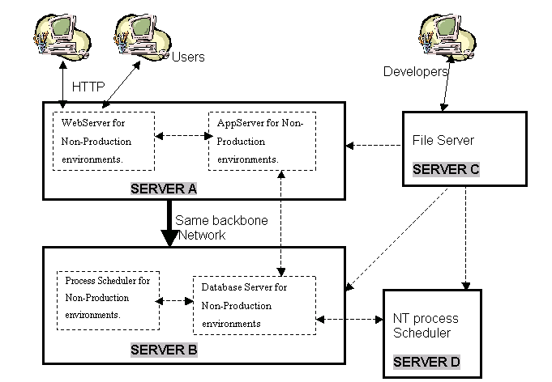
Technical Architecture – overview (Cont…)
Non-Production Environment Architecture

Slide 35
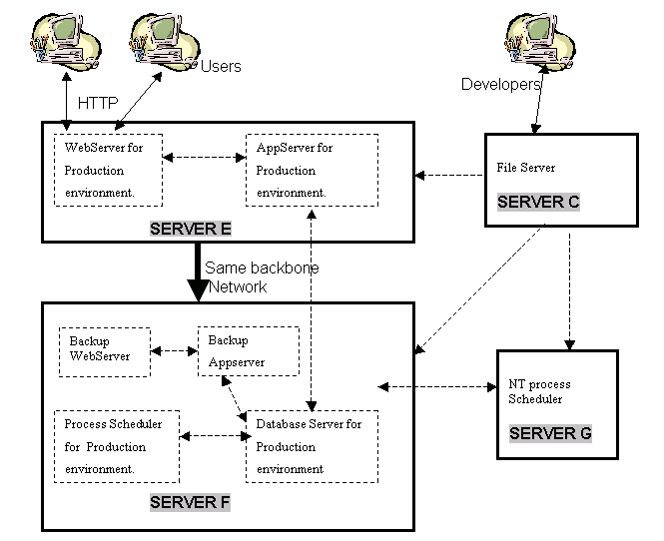
Technical Architecture – overview (Cont…)
Production Environment Architecture

Slide 36
Technical Architecture – overview (Cont…)
Platforms/Products Supported
Web Server
- Windows NT 4
- Windows 2000
- HP-UX
- AIX
- Solaris
- RedHat Linux
- Tru64 (only WebLogic is supported)
- Network operating system such as NetWare or Windows NT/2000, which may be dictated by your RDBMS selection.
File Server
- Intel (Windows)
- HP (HP-UX)
- IBM (AIX)
- Sun (Solaris)
- Compaq (Tru64)
- z/OS
Batch Server
-

Slide 37
Technical Architecture – overview (Cont…)
Platforms/Products Supported (Cont…)
- Windows NT 4.0 with Service Pack 5
or higher applied, or Windows 2000.
        - Sun/Solaris
        - HP/HP-UX
        - IBM/AIX
        - TRU64
Application Server
Development Environment
        - Windows NT 4
        - Windows 2000

Slide 38
Technical Architecture – overview (Cont…)
Platforms/Products Supported (Cont…)
Databases Supported
Oracle for Solaris, HP-UX, AIX, Tru64 UNIX, and Windows
Microsoft SQL Server for Windows
DB2 UDB for OS/390 and z/OS, AIX, Solaris, HP-UX, and Windows
Sybase for Solaris, HP-UX, AIX, and Tru64 UNIX
Informix for Solaris, HP-UX, AIX, and Tru64 UNIX

Slide 39
Technical Architecture – overview (Cont…)
Platforms/Products Supported (Cont…)
Third Party Tools Used
BEA Tuxedo (Supplied by PeopleSoft)
BEA WebLogic OR IBM (Supplied by PeopleSoft)
WebSphere as a Web Server
Crystal reports (Supplied by PeopleSoft)
Database Software (Need to be purchased separately)
COBOL Compiler (Need to be purchased separately, If required)
Microsoft Office (Need to be purchased separately)
PDF Acrobat reader (Available as a free download)
Directory server / software (Need to be purchased separately, If required)

Slide 40
Capgemini India – PeopleSoft Practice
PeopleTools - Overview

Slide 41
PeopleTools overview
Application Designer
Data Mover
Security

Slide 42
PeopleTools overview (Cont…)
Application Designer
Development tools to design/Build PeopleSoft applications. Some of the commonly used objects are as follows:
  Field
  Record
  Page
  Component
  Menu
  Message
  Message Channel
  Project
  SQL

Slide 43
PeopleTools overview (Cont…)
Application Designer (Cont…)
Other Users of Application Designer
Copying Projects to other environments
Writing/Validating PeopleCode
PeopleCode Debugging
Building Records
Change control for online objects

Slide 44
PeopleTools overview (Cont…)
Data Mover
Data Mover as name suggests is used for data Manipulation.
Mainly used for:
Installation
Data Import/Export
Upgrades

Slide 45
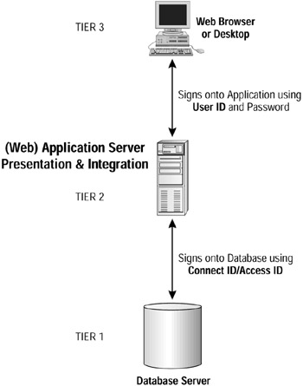
PeopleTools overview (Cont…)
Security

Slide 46
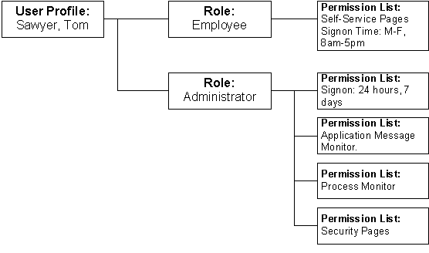
PeopleTools overview (Cont…)
Security (Cont…)

Slide 47
PeopleTools overview (Cont…)
Security (Cont…)
PeopleSoft security tries to address following needs:
WHAT information a user can see (by table and rows)
WHAT the user can do with this information (by action codes such as "update" and "display")
WHOSE information a user can see (by business unit or department—i.e., Row Level Security)
WHEN this information can be accessed (through a "time of day" feature)
HOW LONG the information can be viewed (with a "time out" feature)

Slide 48
PeopleTools overview (Cont…)
Security (Cont…)
  Menu Security
  Row Level Security
  Field Level Security (Hide/Unhide fields using PeopleCode)
  Object Security
  Query Security
  Process Groups

Slide 49
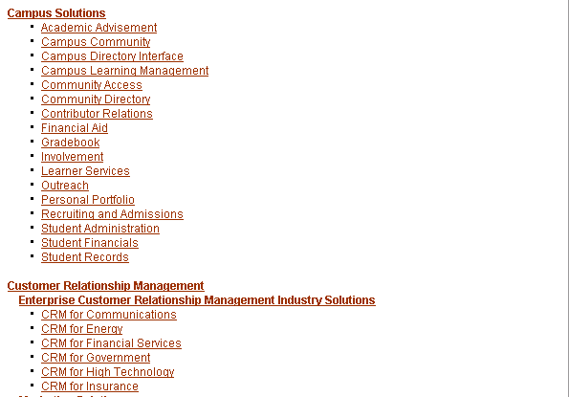
Module Listing (http://www.peoplesoft.com/corp/en/products/ent/index.jsp)

Slide 50
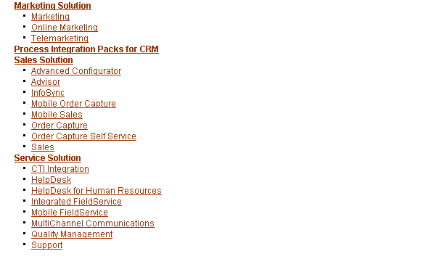
Module Listing (cont…)

Slide 51
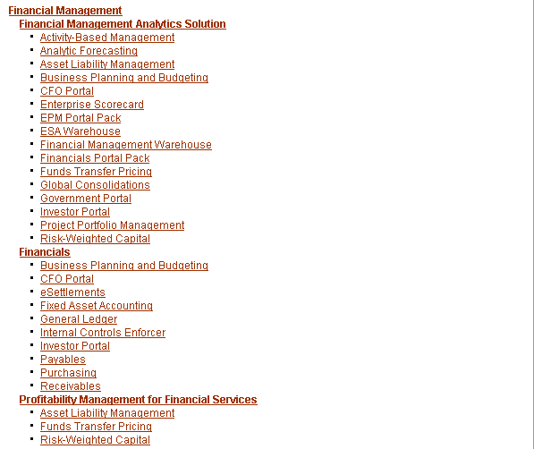
Module Listing (cont…)

Slide 52
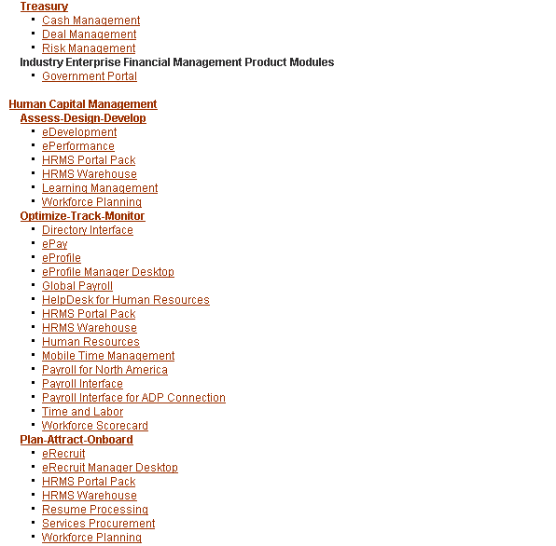
Module Listing (cont…)

Slide 53
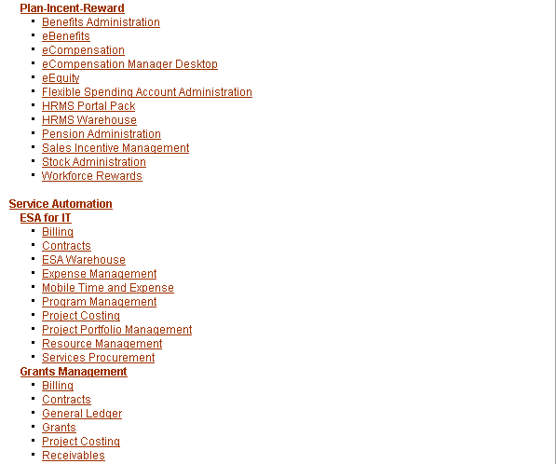
Module Listing (cont…)

Slide 54

Module Listing (cont…)

Slide 55
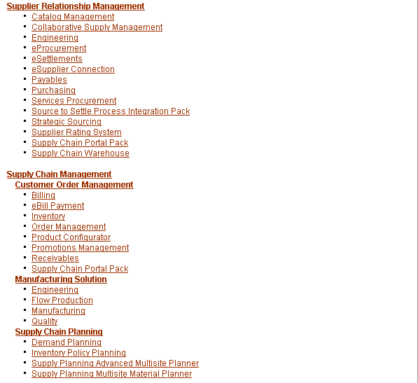
Module Listing (cont…)

Slide 56
Capgemini India – PeopleSoft Practice
Thank You.........!!!!!!!!!!!!!!!!!!

